Slide 1
GIFT OF LIFE
GIFT OF LIFE
DR GURBAKSH SINGH

Slide 2

At Ohio State University, USA I found an American student looking again and again at me when we were attending our first maths class there.
Next week, when I was waiting outside the classroom for the bell to ring, the student came to me and said, "Hello."
When I answered him, he surprised me by asking a totally unexpected question, "Are you a Sikh?"
After a moment's silence, I said, "Yes." The bell rang and we went to the class.

Slide 3
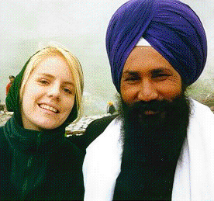
When she met me again, she was very respectful to me and asked, "My father wants to talk to you.
Can you find time any day in the evening to have tea at our house? I can pick you up from your room and drive you back to your place."
This was the first time an American student treated me like that.
I felt I was no longer a stranger at the campus, somebody was interested in me there.

Slide 4
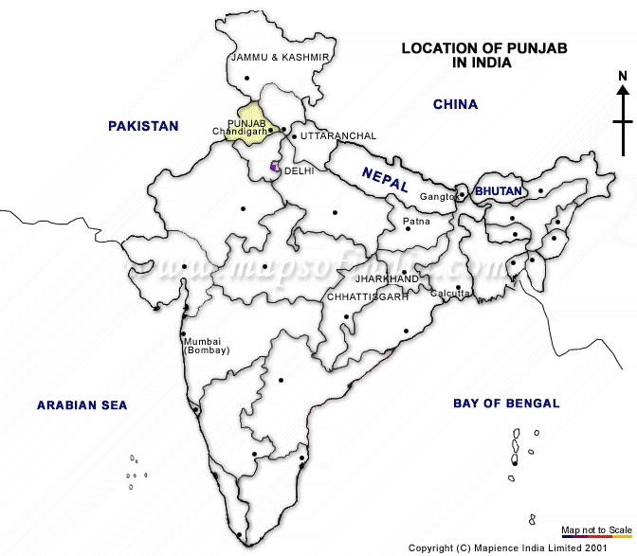

My friend drove me to her house.
When we reached there, their father was sitting in the living room with an open atlas on a coffee table in front of him.
As a usual courtesy, I greeted him and waited for his response.
Without listening to me, he put his finger near Jalandhar on the Panjab map.
He said something with great excitement, which I could not understand.
Hence I kept silent.

Slide 5
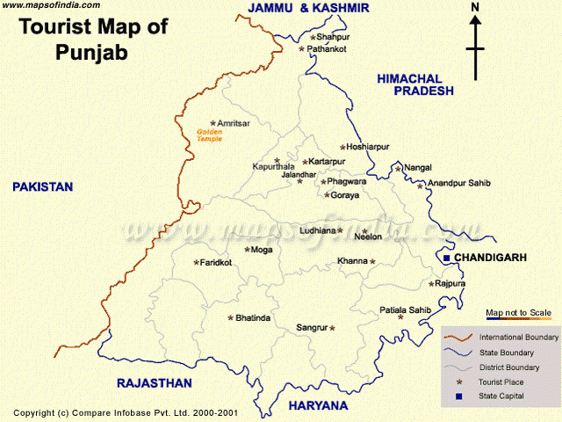
He emotionally repeated his question very fast.
Again, I could not make any thing of what he uttered.
Finding me a bit confused, the student repeated his father's question slowly, "Where is your village?“
Without caring to know what I said and remaining deeply charged with emotions, the father continued, "A Sikh who belonged to this village saved my life.

Slide 6

As long as you stay in Columbus, we will be glad to be available to you for any kind of service."
It is impossible for me today to describe his excitement and the words he spoke.
There was a lot unsaid that could only be understood from his emotions and his expressions.

Slide 7
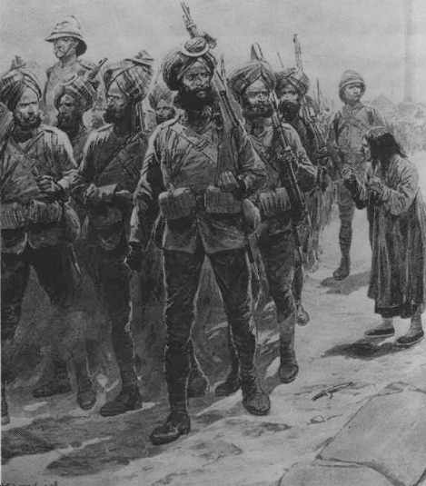
. What he told me in so many words can briefly be described as follows
"Neither my son nor I would be here but for the sacrifice of the Sikh from this village.
During World War II, we were fighting in North Africa when the Germans were raining bullets on us.
We received orders to retreat and save our lives.

Slide 8
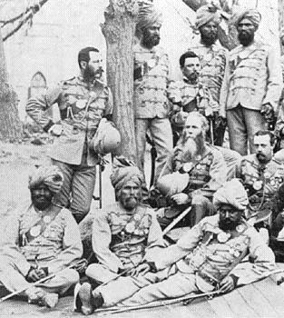
I was unable to move, I had been seriously wounded.
Instead of retreating to safety, the Sikh risked his own life and dragged himself to me.
He put me on his back and snailed some distance on his stomach towards the trench.
When in the trench, he moved on all fours, carrying me on his back ... We were finally out of danger.

Slide 9
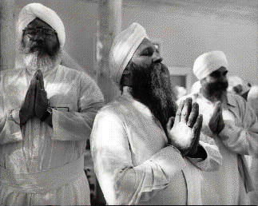
I am alive today.
This life is a gift given to me by a Sikh.
Sikhs are the best people I have ever met.“
There was no end to his words, and he continued talking about the Sikhs for a few minutes.
Whereas my ears were listening to him, my mind was tuned to the sacrifice made by that Sikh whose brave deeds raised the image of our community.
I prayed in my heart, "God, thank you for giving me birth in a Sikh family. I request you to give me the strength and bravery of a Sikh so that I may live a life worthy of a Sikh."

Slide 10
wise and brave Sikhs
. My two Sikh friends and I were invited to attend the marriage.
We were treated as VIP guests.
Our appearance looked unusual to everyone there.
After the marriage, a girl in her pre-teens sitting near us asked a question from the groom,
"Are they the three wise men who are mentioned in the Bible? Are their beards real?"
Everybody started smiling.
The father replied, "Yes, they are the wise and brave Sikhs; yes they have real beards."

Slide 11
great honor to be a Sikh !
After hearing these words said in appreciation of the Sikh community, I got tears in my eyes. Drenched in those emotions, my mind told me,
"What a great honor to be a Sikh !
We Sikhs must perform good deeds to maintain this great image of our community so that we can pass this rich heritage on to our coming generations."

